Slide 1
SOLUTIONS: Implicit Bias, Racial Anxiety & Stereotype Threat in Health Care
Rachel D. Godsil, JD
Director of Research & Co-Founder
Perception Institute
@perceptioninst

Slide 2
HISTORICAL TRUTHS
“Some patients, though conscious that their condition is perilous, recover their health simply through their contentment with the goodness of the physician.” —Hippocrates (460---400 BC)
(Aronson et al., 2013)
Notes:
quality of patient--- provider relations, even in the modern era, remains a significant influence on patient outcomes.1b Indeed, research consistently finds that the way patients and their health care providers interact can matter more than even the training or expertise of the doctors and medical staff who treat them. Interaction quality affects how well patients understand information presented during visits, the amount of pertinent information they later recall, their satisfaction with their treatment, and their adherence to the recommended treatment regimen.2,3
Thousands of studies have documented racial disparities in medical care, which an Institute of Medicine panel defines as “racial or ethnic differences in the quality of health care that are not due to access-related factors or clinical needs, preferences, and appropriateness of the intervention.” 5(pp3---4) Although some of these disparities occur because racial minorities tend to receive care in underresourced health care facilities,5,6 racial disparities also exist in highquality health care facilities.5,7

Slide 3
PRESENT DAY TRUTHS
Studies have documented “racial or ethnic differences in the quality of health care that are not due to access-related factors or clinical needs, preferences, and appropriateness of the intervention.” (Aronson et al. 2013)
The differences are found in high resourced institutions – and compound the disparities that are a result of structural factors.

Slide 4

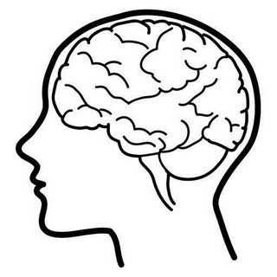
DEFINITION: IMPLICIT BIAS
Implicit bias refers to the brain’s automatic, instant association of stereotypes or attitudes toward particular groups, without our conscious awareness.

Slide 5
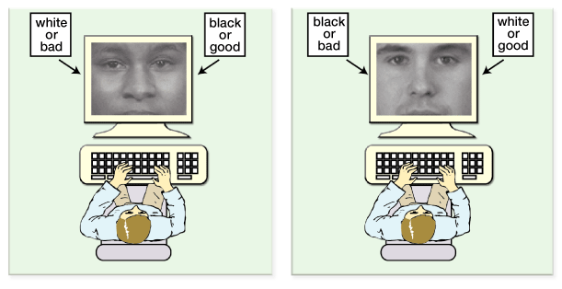


HOW DO WE KNOW
WE HAVE BIAS?
Implicit Association Test (IAT): https://implicit.harvard.edu/implicit/

Slide 6


IMPLICIT BIAS IN HEALTHCARE
Findings of bias among providers
  High levels of bias leads to less friendly & lower patient satisfaction ((Blair, Steiner, et al., 2013; Cooper et al., 2012; Penner et al., 2010)
  Differential interpretation of clinical presentation (e.g. cardiac patients) (Green et al., 2007)
  Differential treatment recommendations (e.g. painkillers, antiretroviral) (Sabin & Greenwald, 2012)
  But see Blair et al. 2014 (hypertension)
Notes:
Ryn et al. (2015) identified several factors that predicted increases in implicit bias during medical school, such as having heard negative comments from supervising medical staff about African American patients, and having had unfavorable contact with African American physicians.

Slide 7
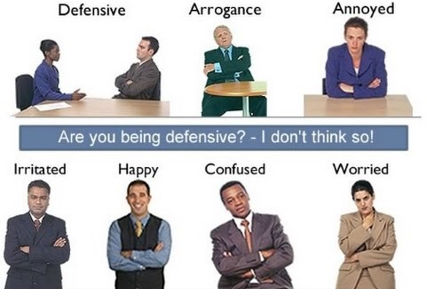
IMPLICIT BIAS IN BEHAVIOR: MICROAGGRESSIONS

Slide 8
NONVERBAL BIAS AMONG PHYSICIANS
Physicians in end-of-life care show different nonverbal communication toward black patients
    time spent with open body language
    time interacting with patient (instead of the chart, nurse, etc.)
    time touching the patient
    physical distance from the patient
Elliott, A. M., Alexander, S. C., Mescher, C. A., Mohan, D., & Barnato, A. E. (2016). Differences in Physicians' Verbal and Nonverbal Communication With Black and White Patients at the End of Life. Journal of pain and symptom management, 51(1), 1-8.
Notes:
**NEW STUDY (2016)
- Video and audio recording of physician interaction with patients receiving end of life care
No difference in verbal communication by race of patient
Difference in NONVERBAL communication, as rated by third-party observer
Elliott, A. M., Alexander, S. C., Mescher, C. A., Mohan, D., & Barnato, A. E. (2016). Differences in Physicians' Verbal and Nonverbal Communication With Black and White Patients at the End of Life. Journal of pain and symptom management, 51(1), 1-8.

Slide 9
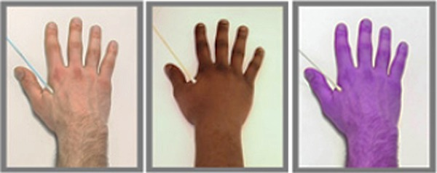
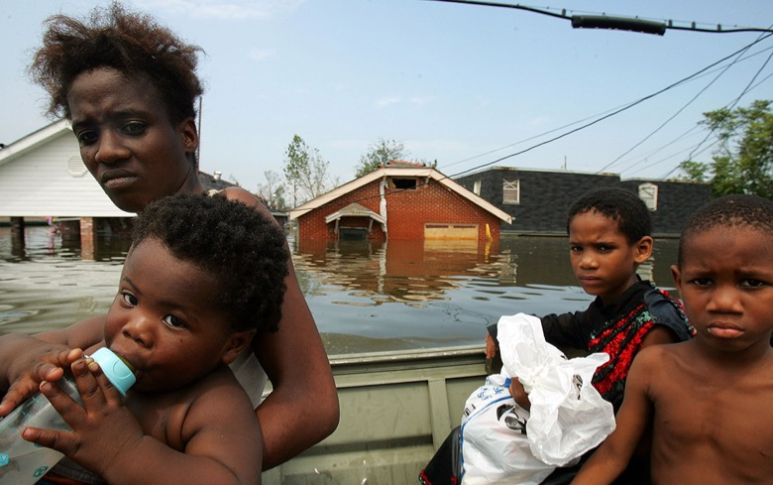
DEFINITION: INFRAHUMANIZATION
Belief that one’s group is more human than the ‘othered’ group
We can identify basic emotions (joy, anger) in ‘others’ but not nuanced emotions (anguish, regret)
Less empathy and willingness to help

Slide 10
IMPLICIT BIAS IS . . .
INCREASED BY
NOT REDUCED BY
stress
time pressure
multi-tasking
lack of clear criteria for decision-making
ambiguous or incomplete information
lack of familiarity with people from the group
X good intentions
X someone else telling
you to reduce your bias
X suppressing bias
X avoiding people from
other groups
X thinking you don’t
have bias

Slide 11
BREAKING THE PREJUDICE HABIT (Devine et al. 2012)
Stereotype replacement - identify stereotype-based behavior, replace with non-stereotypical response
  Counter-stereotypic imaging - imagining in detail counter-stereotypic others, to make positive exemplars more accessible
  Individuation - prevent stereotypic inferences by obtaining specific information about group members
  Perspective-taking - taking the perspective in the first person of a member of a stereotyped group
  Increase opportunities for contact - seeking opportunities to encounter and engage in positive interactions with out-group members
Notes:
Bias is malleable
Breaking the Prejudice Habit :
Engender awareness of one’s biases
Engender concern about the consequences of bias (i.e., motivation to eliminate it)
Knowledge about when biased responses are likely to occur
Replace biased responses with responses reflecting non-prejudiced goals
___________
Stereotype replacement. replacing stereotypical responses for non-stereotypical responses. involves recognizing that a response is based on stereotypes, labeling the response as stereotypical, and reflecting on why the response occurred. Next one considers how the biased response could be avoided in the future and replaces it with an unbiased response. (e.g., woman walks out of an afternoon meeting vs man walks out – stereotype of mother)
Counter-stereotypic imaging. imagining in detail counter-stereotypic others (Blair et al., 2001). These others can be abstract (e.g., smart Latinos), famous (e.g., Barack Obama), or non-famous (e.g., a personal friend). The strategy makes positive exemplars salient and accessible when challenging a stereotype’s validity.
Individuation. This strategy relies on preventing schematic inferences by obtaining specific information about group members. Using this strategy helps people evaluate members of the target group based on personal, rather than group-based, attributes. **especially in healthcare – having providers focus on the patient at hand, rather than relying on group risk factors, reduces the impact of bias**
Perspective taking. This strategy involves taking the perspective in the first person of a member of a stereotyped group. Perspective taking increases psychological closeness to the stigmatized group, which decreases automatic schematic thinking (Galinsky & Moskowitz, 2000—a day in the life of an elderly man vs. try to suppress your stereotypes).
Increasing opportunities for contact. This strategy involves seeking opportunities to encounter and engage in positive interactions with out-group members. Increased contact can decrease implicit bias through a wide variety of mechanisms, including altering the cognitive representations of the group or by directly improving evaluations of the group.

Slide 12
ADDRESSING BIAS IN HEALTHCARE
“Being made aware of implicit bias through self-reflection activities, like feedback from an IAT, may motivate health care providers to address their implicit biases,
but perhaps only if the feedback and reflection activity does not induce the defensiveness that can lead them to deny their bias, or counterargue the issue of disparities” (Zestcott et al., 2016)
Notes:
- Don’t give yourself opportunity to act on bias

Slide 13
DEFINITION: RACIAL ANXIETY
Racial Anxiety is the brain’s stress response before or during inter-racial interactions.
People of color fear they will experience discrimination, hostile treatment, or invalidation.
White people fear their actions will be perceived as racist.

Slide 14

RACIAL ANXIETY IN HEALTHCARE
Biased providers speak faster, speak more, have shorter visits with patients of color
Black patients of these providers report:
  care is less patient-centered and lower quality
  provider is less warm and less friendly
  lower levels of trust and satisfaction
Chapman, E. N., Kaatz, A., & Carnes, M. (2013). Physicians and implicit bias: how doctors may unwittingly perpetuate health care disparities. Journal of general internal medicine, 28(11), 1504-1510.
Notes:
- Implicit bias impacts patient-provider interactions, as rated by an observer and by the patient
Bias may influence care engagement – especially adherence and follow-up
Chapman, E. N., Kaatz, A., & Carnes, M. (2013). Physicians and implicit bias: how doctors may unwittingly perpetuate health care disparities. Journal of general internal medicine, 28(11), 1504-1510.

Slide 15

SOLUTIONS: RACIAL ANXIETY
Identify potential triggers
Develop language ahead of time to ease the initial interaction and allow anxiety to dissipate
Affirm confidence and desire in inter-racial relationships

Slide 16
DEFINITION: STEREOTYPE THREAT
Stereotype threat is the fear of being judged based upon negative stereotypes about one’s group.
  Effects include attention divided between the task and the concern about being seen as a stereotype
  Leads to underperformance (Steele et al., 1995)
  Stereotype threat elevates blood pressure, induces anxiety, and increases aggressive behavior, overeating, and a host of other failures of self-regulation. (Phelan, 2010)

Slide 17
AWARENESS OF STEREOTYPES IN HEALTH CARE (Abdou & Fingerhut, 2014)
Black women report worrying about stereotypes and feeling like doctors and other medical professionals treat them differently because of their race or ethnicity (Lillie-Blanton et al., 2000).
I think there is...some kind of prejudice of the name...there’s a lack of respect. They think they can get away with a lot because “Here’s another dumb Mexican.” –Mexican American patient (Burgess, 2010)

Slide 18
APPLICATION TO HEALTH CARE
Avoidance of health care.
Impaired communications with health care providers.
Poor adherence to treatment plan.
(Aronson et al., 2013)
Discounting feedback – about elevated blood sugar levels or negative effects of smoking.
Dis-identification – viewing health promotion behaviors as “white.” (Burgess et al. 2010)
Notes:
Stereotype threat also has been shown to lead individuals to discount the importance or validity of feedback in domains in which he or she feels threatened. 26,27,68 In the context of healthcare. a diabetic patient experiencing stereotype threat might discount feedback about elevated HbA1c levels, or a smoker might dismiss information about the negative effects of smoking. 4. Disengagement. Stereotype threat is an unpleasant experience and may lead to avoidance of and disengagement from situations in which the threat occurs.33 If going to the doctor engenders feelings of inferiority, the patient might be more likely to avoid those experiences. This might help explain
Disidentification—a long term consequence of stereotype threat in which individuals cease to identify with the domain within which they consistently experience the threat70—would help explain the tendency of racial/ethnic minorities to view health promotion behaviors (e.g., exercising and healthy eating) as “white” and unhealthy behaviors (e.g., eating fast food and red meat) as characteristic of their racial/ethnic group.

Slide 19
STUDY OF STEREOTYPE THREAT IN HEALTH CARE (Abdou & Fingerhut, 2014)
First-of-its kind study – virtual waiting room containing posters of a young Black pregnant woman & Black baby with the caption: “She has her father’s eyes and her mother’s AIDS–Know HIV & AIDS.”
Black women in the stereotype threat condition who were strongly identified as Black reported significantly greater anxiety in the experimental health care setting than all other women.

Slide 20
SOLUTIONS:
STEREOTYPE THREAT
Create an environment that is identity-safe (Steele, 2010)
Increase feelings of social belonging (Walton & Cohen, 2011)
Encourage self-affirmation (Cohen et al. 2006)
Remove triggers for stereotype threat (Walton & Spencer, 2009)
Promote a growth mindset (Dweck, 2006)
Give feedback so it is trusted and motivating (Cohen et al., 1999)
Notes:
- Identity-safe environment
Social belonging so that unique identity characteristics are not as salient
Self-affirmation – of values, personal assets/strengths
Remove triggers in the evnironment and on tasks
Promote a growth mindset so that abilities are seen as something that can be developed, and so that negative performance is not “stereotype-confirming evidence”
Give feedback that is trusted and motivating (wise criticism)

Slide 21
SOLUTIONS IN HEALTH CARE:
STEREOTYPE THREAT
Whole clinic approach to discrimination and bias reduction – bias experience often linked to non-clinical staff (Barr et al., 2005)
Provide cues that patients of color are valued - health care providers of color is a powerful indicator (Marx et al., 2005, 2009)
Address patient anxiety – soothing environments and patient support (Aronson et al. 2013)
Affirmation of patient strengths and assets (Walton & Spencer, 2009)
Give feedback so it is trusted and motivating (Cohen et al., 1999)
Notes:
- Identity-safe environment
Social belonging so that unique identity characteristics are not as salient
Self-affirmation – of values, personal assets/strengths
Remove triggers in the evnironment and on tasks
Promote a growth mindset so that abilities are seen as something that can be developed, and so that negative performance is not “stereotype-confirming evidence”
Give feedback that is trusted and motivating (wise criticism)

Slide 22
QUESTIONS AND DISCUSSION

Slide 23
Thank you!
rachel@perception.org
@perceptioninst

